Slide 1
Taxis, Tango, and Tradition in Fair Argentina
My journal of my journey during spring break 2011.
By Karen Cowden, MA Ed. Professor of Reading
(work based on “Kilts, Coos, and Nessie: Scotland in Three Days” by Jean Mauzy)

Slide 2
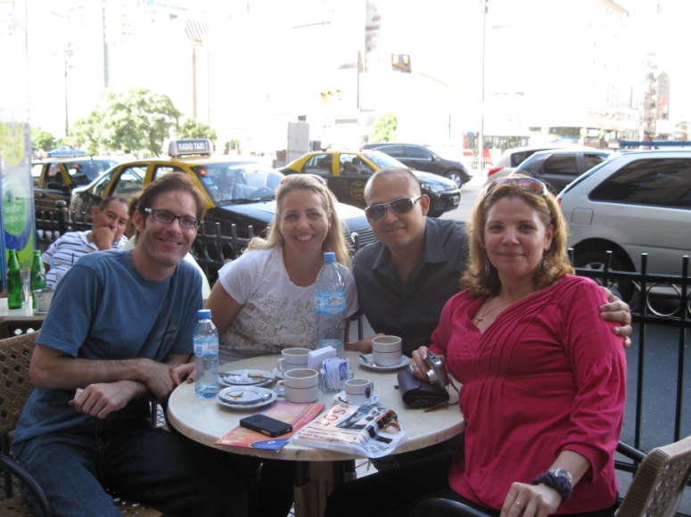
Dr. Troy Gifford, Karen Cowden, Lester Sanders-Rapalo, Ana Caldero-Figuero a having café con leche around the city center.

Slide 3
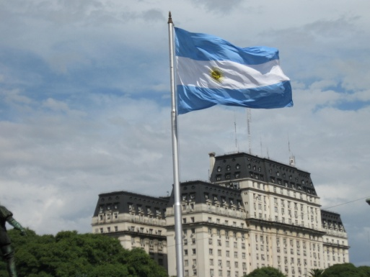
The flag of Argentina overlooking one of the governmental buildings in the downtown area.

Slide 4
Eva Peron. Juan Peron’s first wife, Eva, helped bring public education to the country and implemented plans to have national healthcare coverage.

Slide 5
Ana Caldero-Figueroa sharing the plaza area around Parlemo Soho.

Slide 6
Professor Karen Cowden waving like in the move, “Evita”, off the balcony of the “Casa Rosada”.

Slide 7
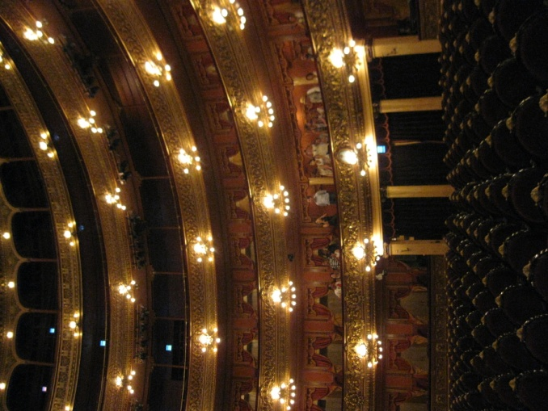
Teatro Colon – a true gem of their cultural arts. It is known around the world as one of the best stages to perform on!

Slide 8
Their country still mourns for their missing citizens from the “Dirty War”.

Slide 9
Dr. Gifford, Lester Sanders-Rapalo, and Ana Caldero-Figueroa in front of the “Casa Rosada”.

Slide 10
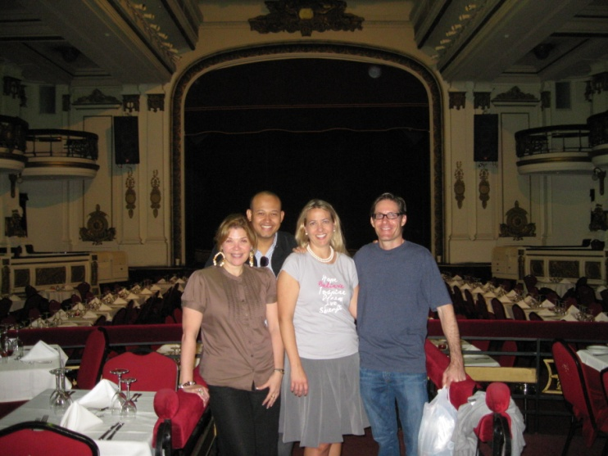
Ana Caldero-Figueroa , Lester Sanders-Rapalo , Karen Cowden, and Dr. Gifford, inside the Astor Piazolla stage.

Slide 11
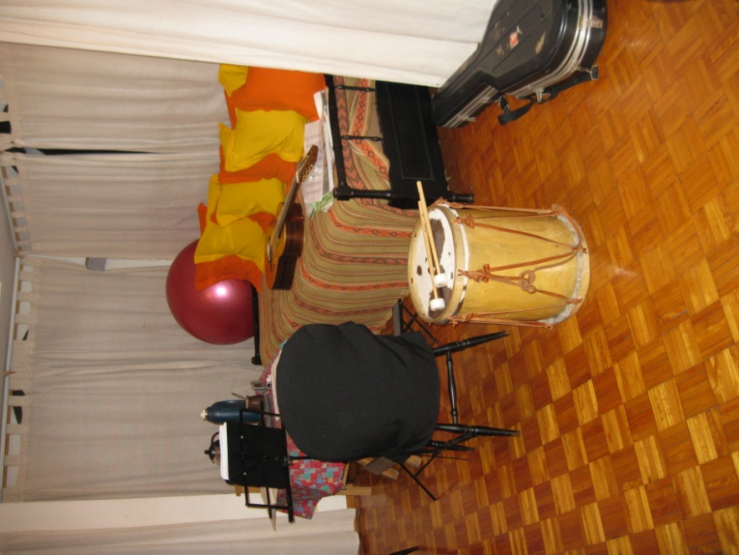
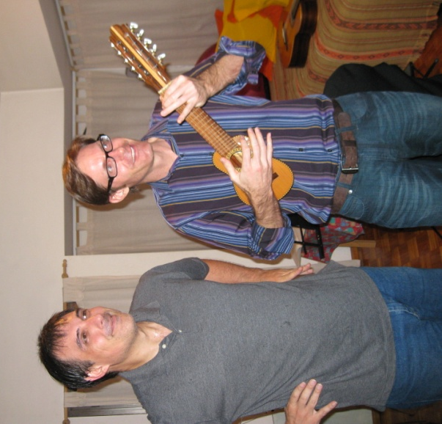
Native Argentinean instruments: Bombo (drums) and guitar (made out of an armadillo’s shell).

Slide 12
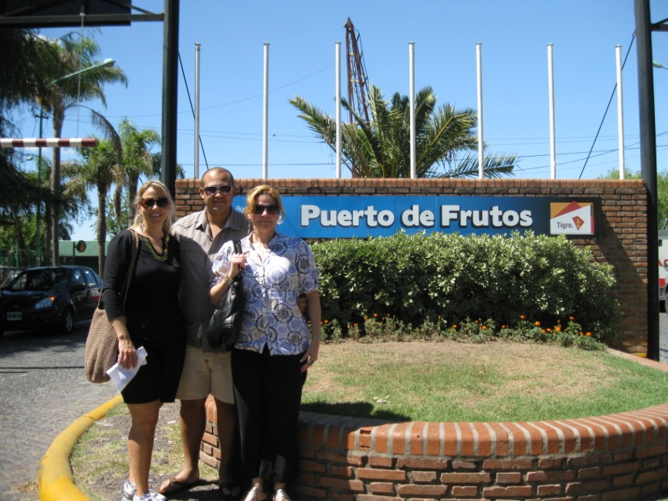
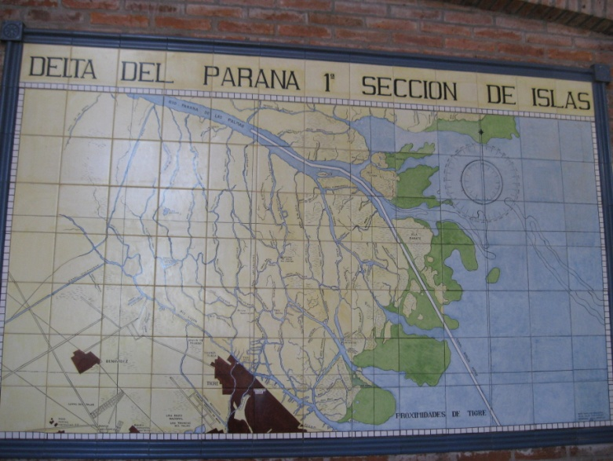
El Tigre area where there are fruit markets and many outdoor cafes.

Slide 13
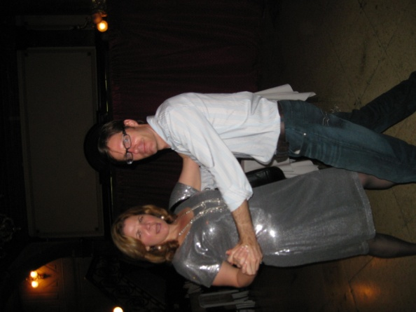
Trying out the Tango!

Slide 14
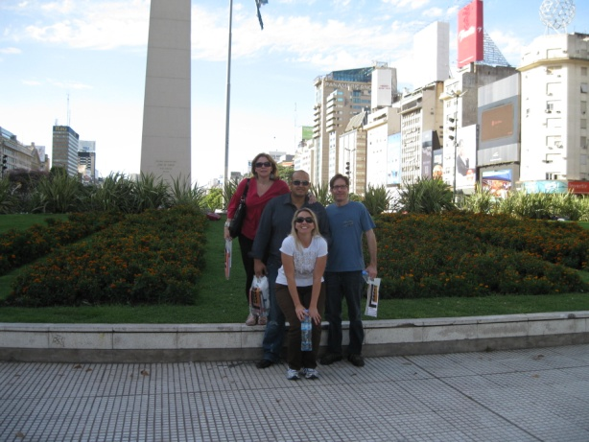
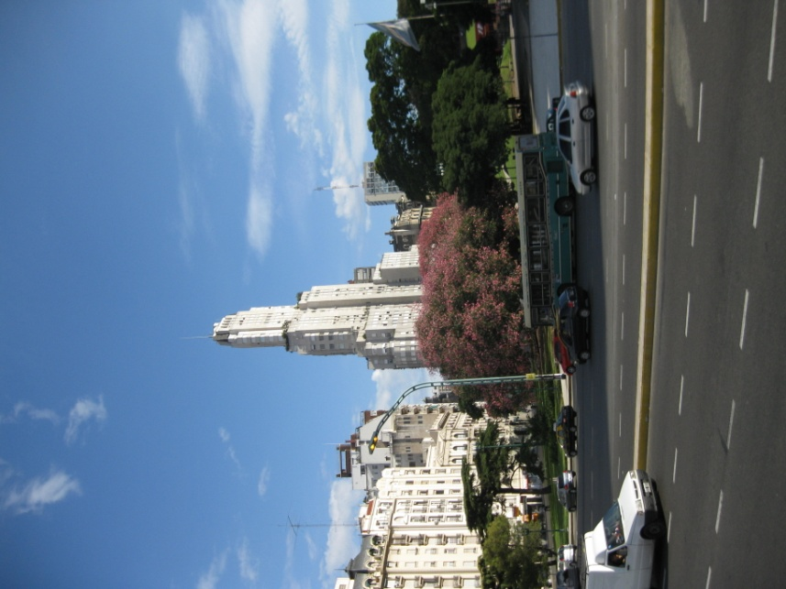
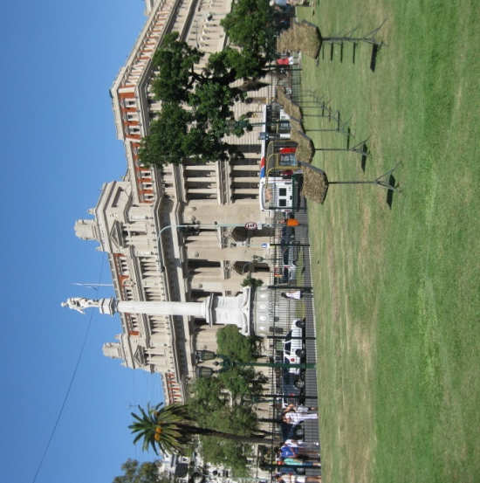
At the obelisk (their city center) which are surrounded by busy streets and beautiful parks.

Slide 15
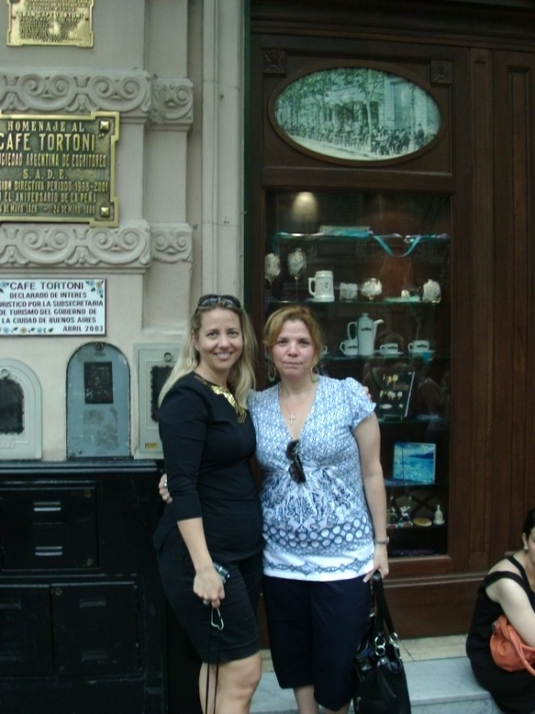
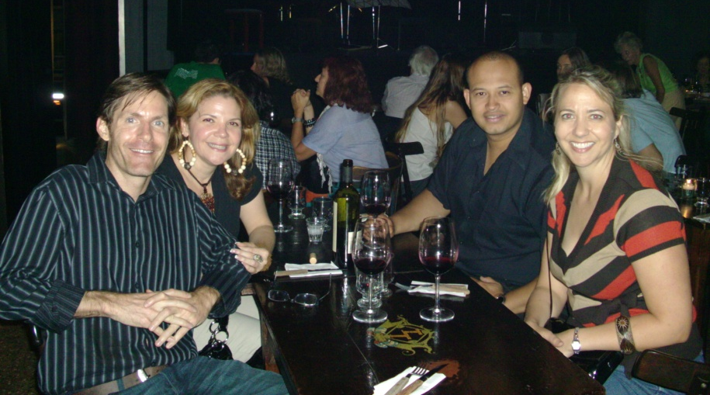
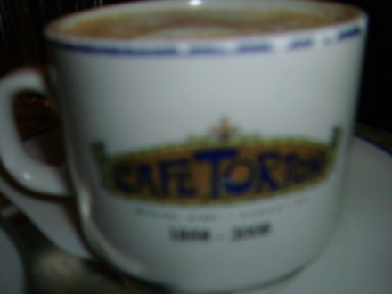
Café Tortoni is a local hang-out for poets, scholars, and thinkers. We enjoyed it all!

